Slide 1
RUNGTA COLLEGE OF DENTAL SCIENCES & RESEARCH
ANTIBODIES
DEPARTMENT OF MICROBIOLOGY

Slide 2
Specific learning Objectives
At the end of this presentation the learner is expected to know ;
Core areas* | Domain ** | Category #
Definition & Srtucture | Psychomotor | Must know
Classes of Immunoglobulins | Psychomotor | Must know
Class switching | Cognitive | Nice to know

Slide 3
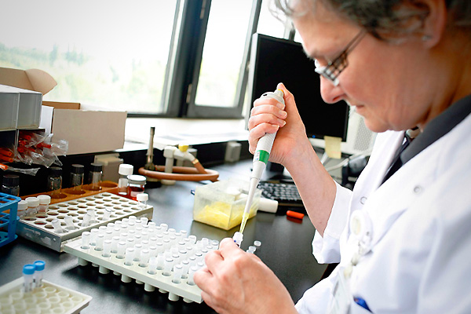
Table of Content
Introduction
Definition
Immunoglobulins
Classes
Mechanism
Class switching

Slide 4
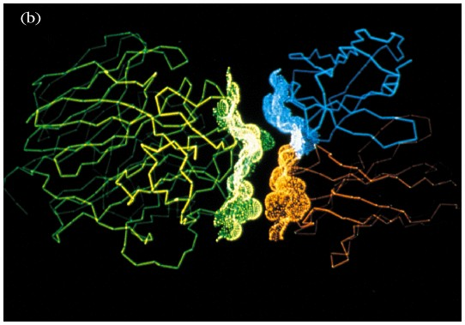
Antigens and Antibodies
Ag
Ab
Complementarity of interacting surfaces of Ab and Ag

Slide 5
Outline
1.

Slide 6
Basic structure of Abs

Slide 7
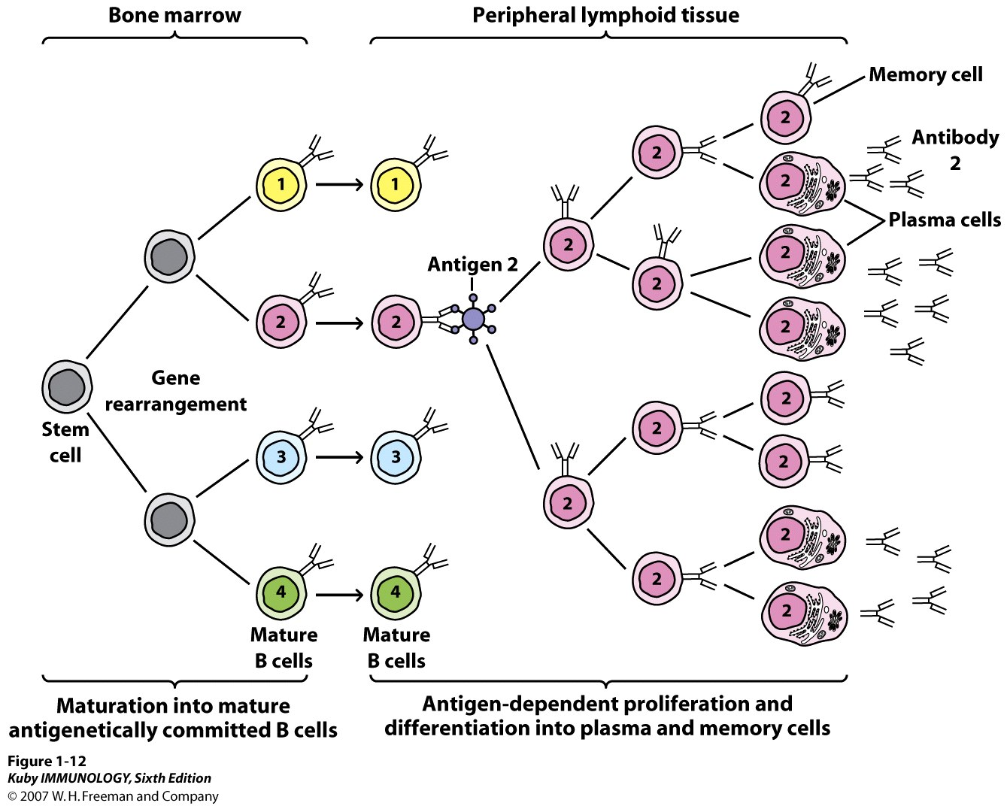

Slide 8
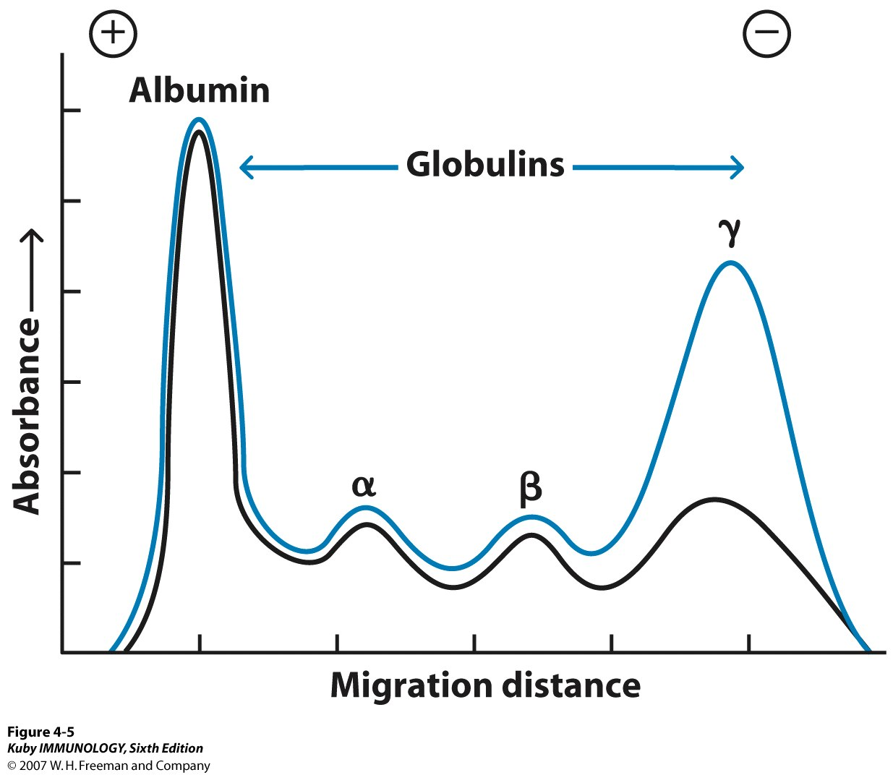
Electrophoresis of immune serum
(Tiselius & Kabat, 1939)
Immune sera
after reaction
with Ag

Slide 9
γ− globulin (γG)
Immunoglobulin (Ig):
IgG, IgM, IgA, IgE, IgD
Antibody (Ab)

Slide 10
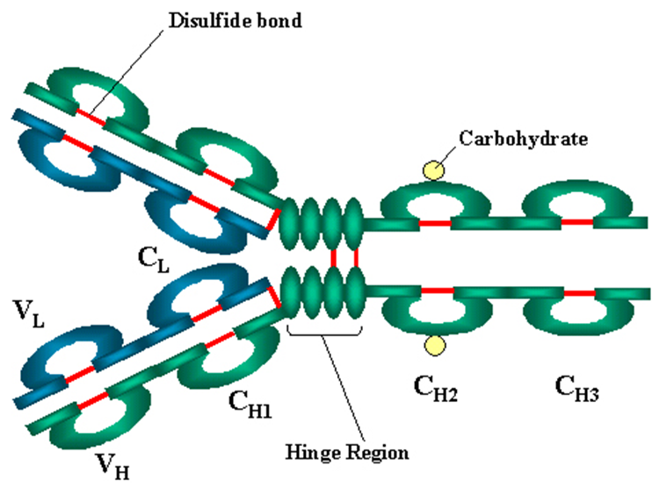
Ab molecules contain 4 peptide chains
- A dimer of heterodimers
V: variable
C: constant
(H)
μ : IgM
γ :IgG
α :IgA
δ : IgD
ε : IgE
(L)
k: Kappa
l: Lambda

Slide 11
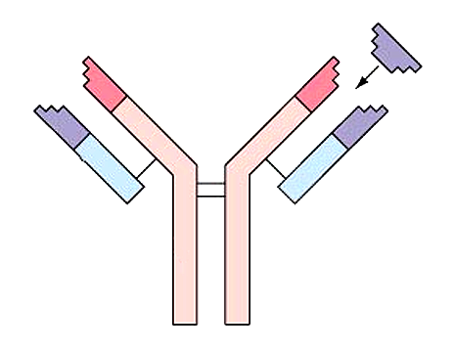
Antibody Molecule
antigen binding sites
antigen
light chains
heavy chains

Slide 12
IgG has a Valence of 2
TWO Identical ANTIGEN BINDING SITES
CH2 CH3
CH2 CH3

Slide 13
Movement
at the
Hinge
Region
IgG
Surface
of an
Antigen
i.e.
bacterial
cell surface
CH2 CH3
CH2 CH3

Slide 14
Non-Covalent Interactions
Ball in glove fit
VL
Antigenic Determinant
VH

Slide 15
Charge-Charge Interactions
Hydrophobic Interactions - And good fit !
VL
+
-
+
Gene rearrangements and
Mutational Hot Spots
VH
-

Slide 16
VL
+
-
Antibody Affinity
Y
+
VH
-

Slide 17
Antigenic determinant 1
Antigenic determinant 2
PROTEIN
ANTIGEN
Antigenic determinant 3
Antigenic determinant 4

Slide 18
MUST HAVE POLYCLONAL ANTIBODY and at least two different antigenic determinants TO CROSS-LINK PROTEIN ANTIGENS
Y
Y
Y
Immune Complexes

Slide 19
More cross-links, and higher individual affinities
= higher AVIDITY of the Immune Complexes
Y
Y
Y
Y
Y
Y

Slide 20
Repeating Antigenic Determinants
e.g. PEPTIDOGYCAN

Slide 21
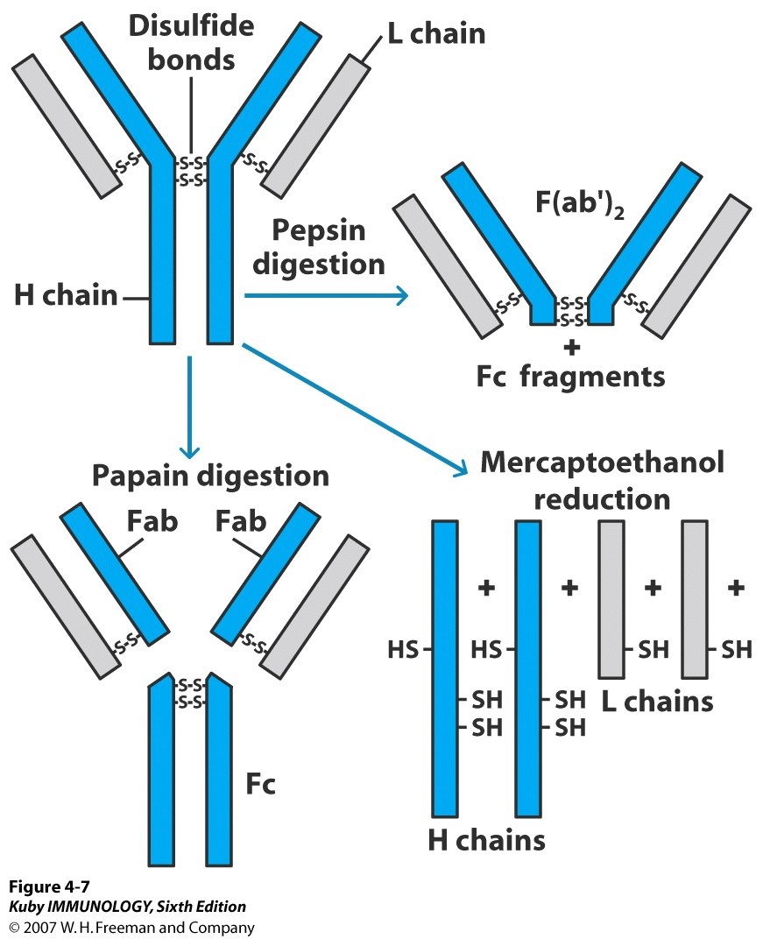
100 kDa
150 kDa
→ numerous small peptides
Fab fragment:
antigen binding
45 kDa
Fc fragment:
crystallizable
50 kDa
22 kDa
50-55 kDa

Slide 22
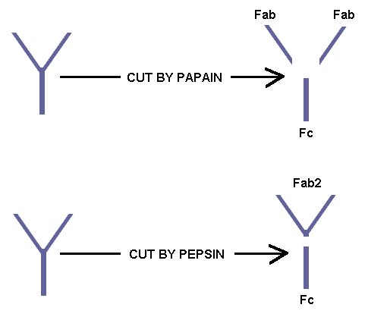

Slide 23
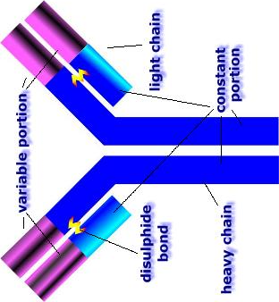
Antibody to the Fab fragment could react with both the H and L chains, whereas antibody to the Fc fragment reacted only with the H chain.
⇒ Fab consists of portions of an H and a L chain.
⇒ Fc contains only H chain components.

Slide 24
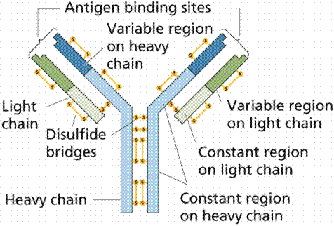

Slide 25
- A heterogeneous spectrum of antibodies
in the serum γ-globulin fraction
- Multiple myeloma: a cancer of Ab-
producing plasma cells
- Myeloma protein: 95% of the serum Ig
- Bence-Jones proteins: the excess light chains
in the urine.
- MOPC: mineral-oil induced plasmacytoma
in mice

Slide 26
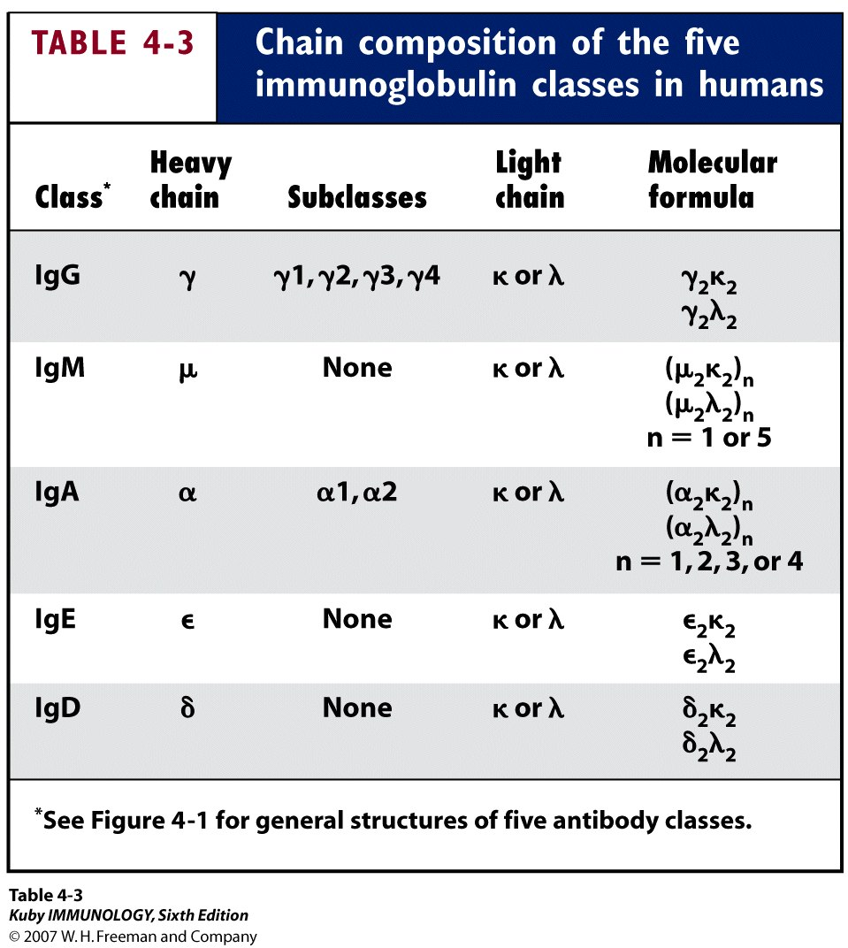

Slide 27
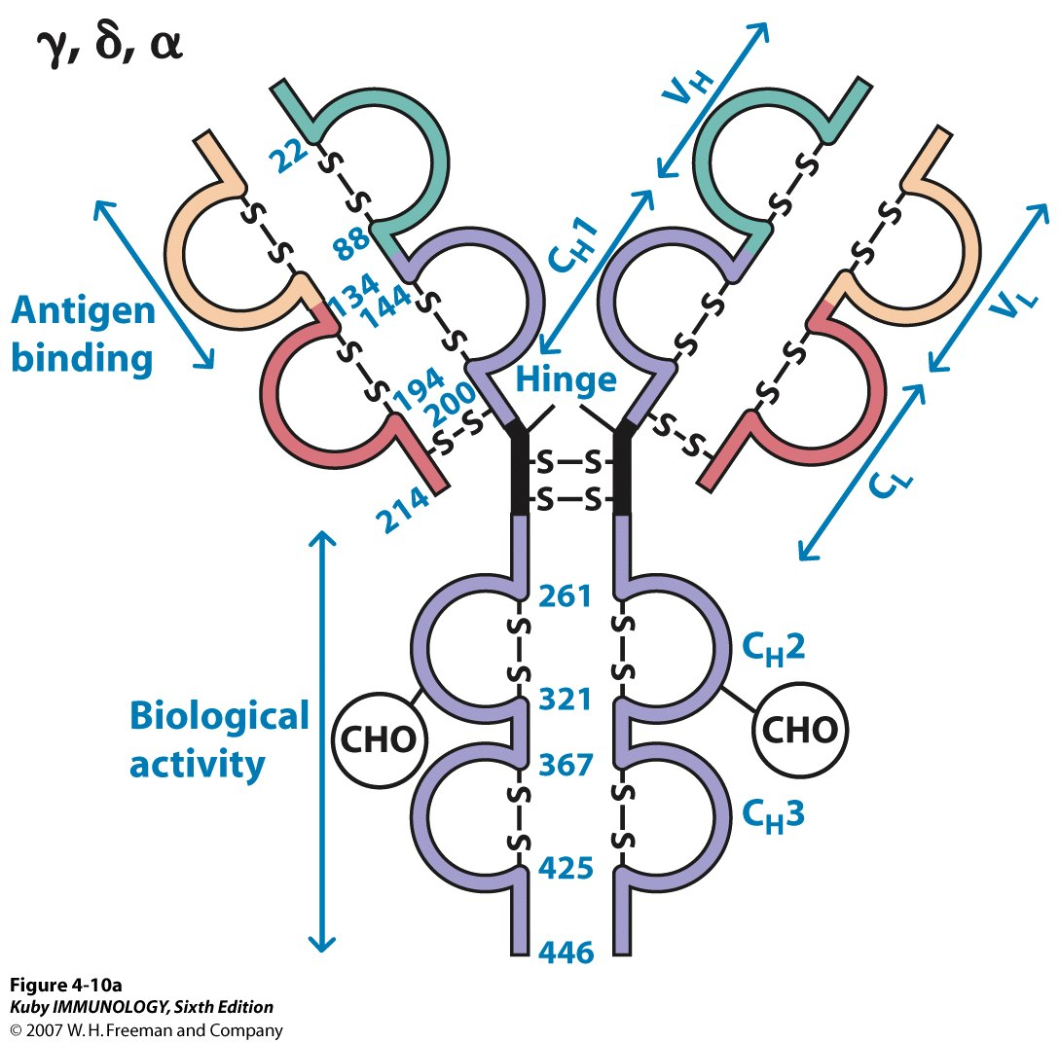
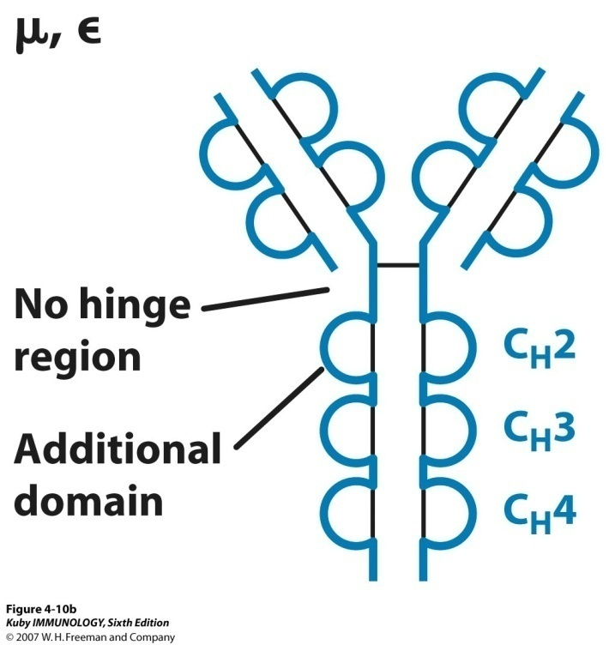
Heavy and light chains
are folded into “domains”
(IgG, IgD, IgA)
(IgM, IgE)

Slide 28
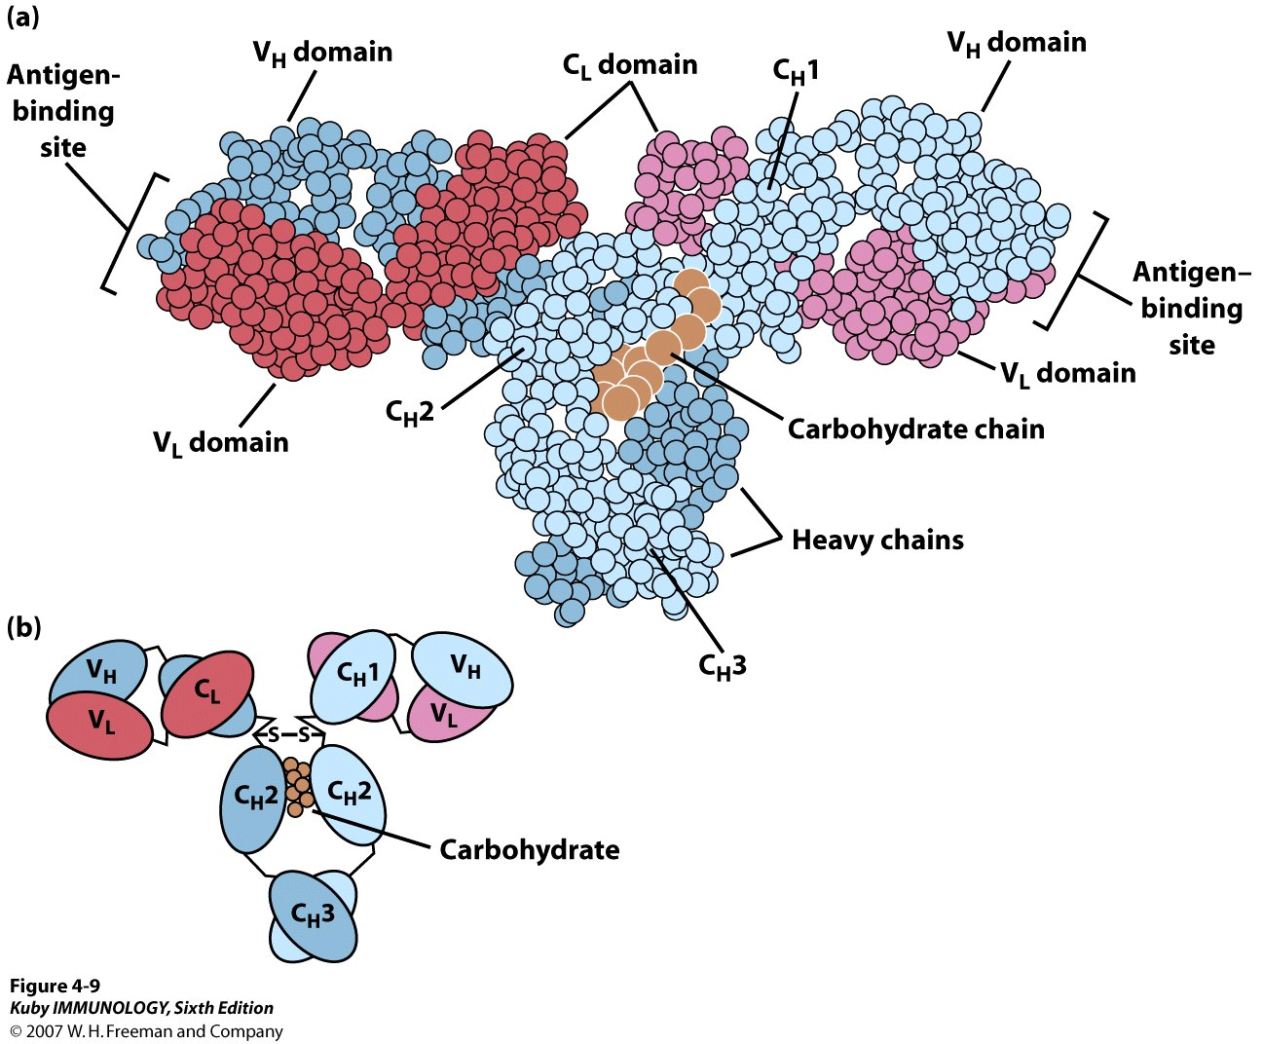
Associations between domains of an Ab molecule
2 Ag-binding sites:

Slide 29
Immunoglobulin Domains
- each contains about 110 a.a. residues and an
intrachain disulfide bond that forms a loop of 60 a.a.
Variable-Region Domains
- hypervariable regions:
(15% - 20% of the variable domain)
= complementarity-determining regions (CDR)
CDR1, CDR2, CDR3
- framework regions (FR)
- diversity in the V_{H} domain is concentrated in CDRs

Slide 30
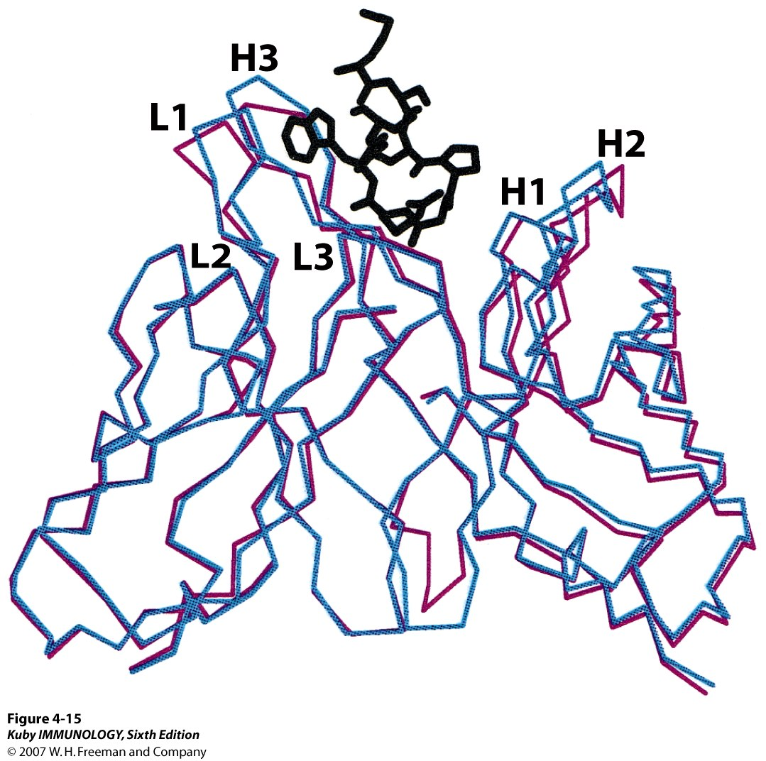
Conformational changes may be induced
by antigen binding
CDRs of L chain : L1, L2, L3
CDRs of H chain : H1, H2, H3
─ : after binding to the Ag
─ : before binding to the Ag
Fab

Slide 31
Ab-mediated effector functions

Slide 32
- Antibodies generally do not kill or remove
pathogens solely by binding to them.
While V regions bind to Ag, the C_{H} region
is responsible for a variety of collaborative
interactions with other proteins, cells, and
tissues that result in the effector functions
of the Ab responses.

Slide 33
Ab-Mediated Effector Functions
Opsonization is promoted by Ab
Abs activate complement
Antibody-dependent cell-mediated cytotoxicity
(ADCC) kills cells
- Some Abs can cross epithelial layers by transcytosis

Slide 34
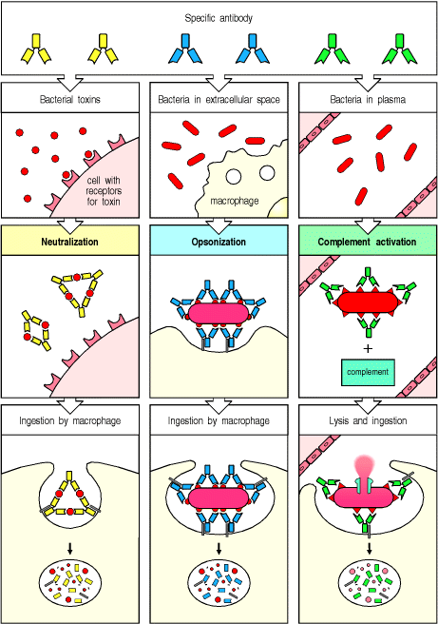
Ab activates complement-mediated cytolysis or promotes opsonization through a binding to C receptors on phagocytes
Ab promotes opsonization through a
binding to Fc receptors (FcR)
on phagocytes

Slide 35
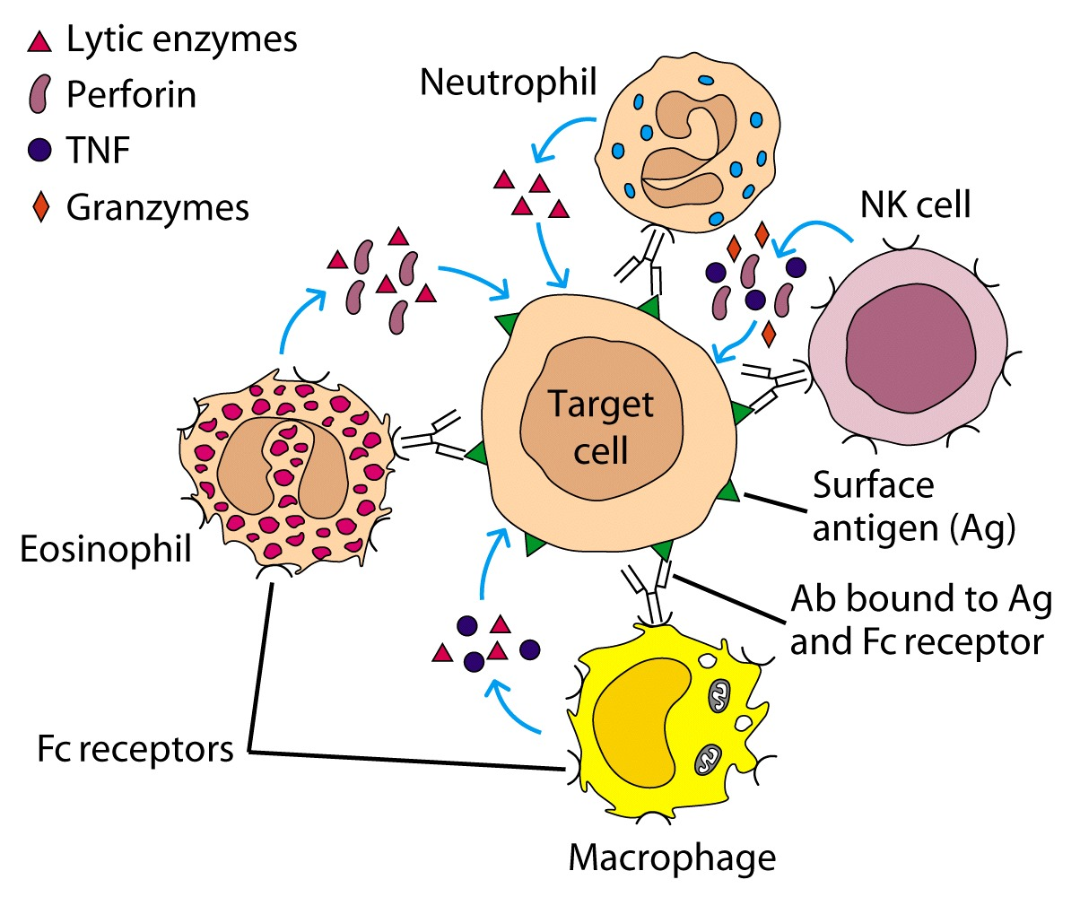
Antibody-dependent cell-mediated cytotoxicity (ADCC)
(Figure 14-15)

Slide 36
Transcytosis
- movement of Ab across epithelial layer
- delivery of IgA to the mucosal surfaces of the
respiratory, gastrointestinal, and urogenital tracts,
as well as its export to breast milk
- transplacental transport of IgG from mother to fetus

Slide 37
Secretory IgA in Breast Milk
Bind to microbes in baby’s digestive tract and
thereby prevent their attachment to the walls of
the gut and their subsequent passage into the
body’s tissues.

Slide 38
Ab classes and
biological activities

Slide 39
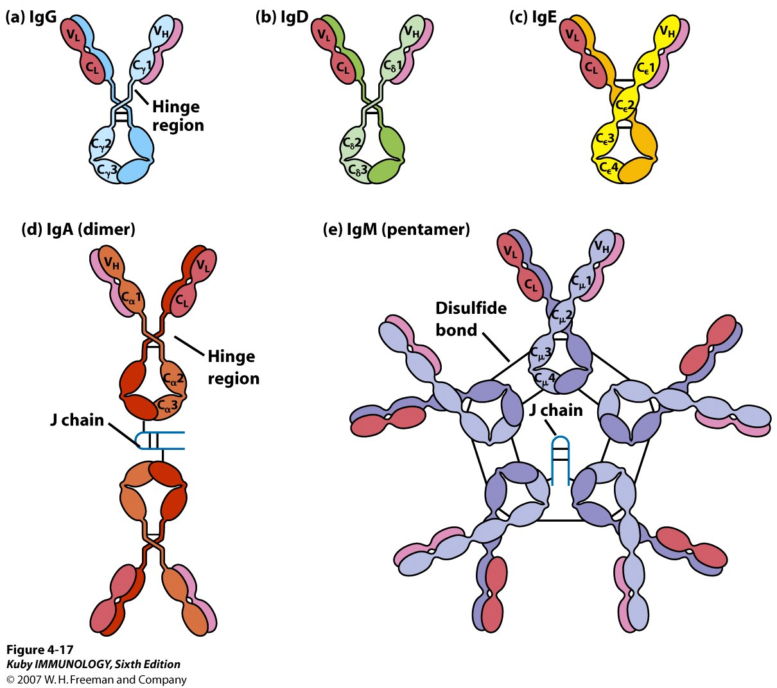
5 major classes of secreted antibody

Slide 40
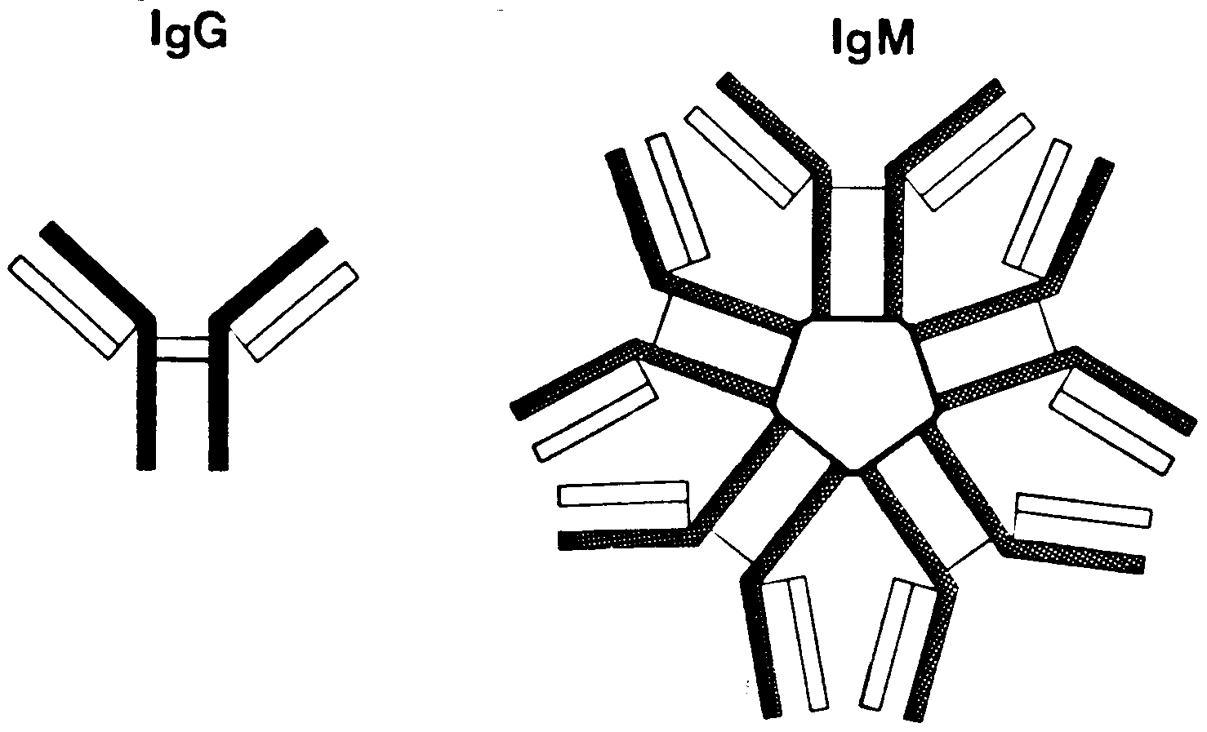

Slide 41
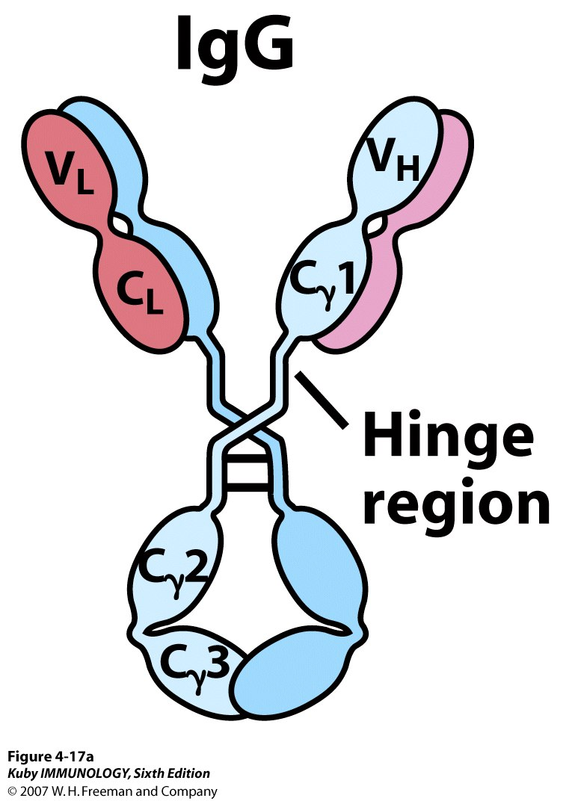
IgG
most abundant in serum
80% of total serum Ig
4 IgG subclasses

Slide 42
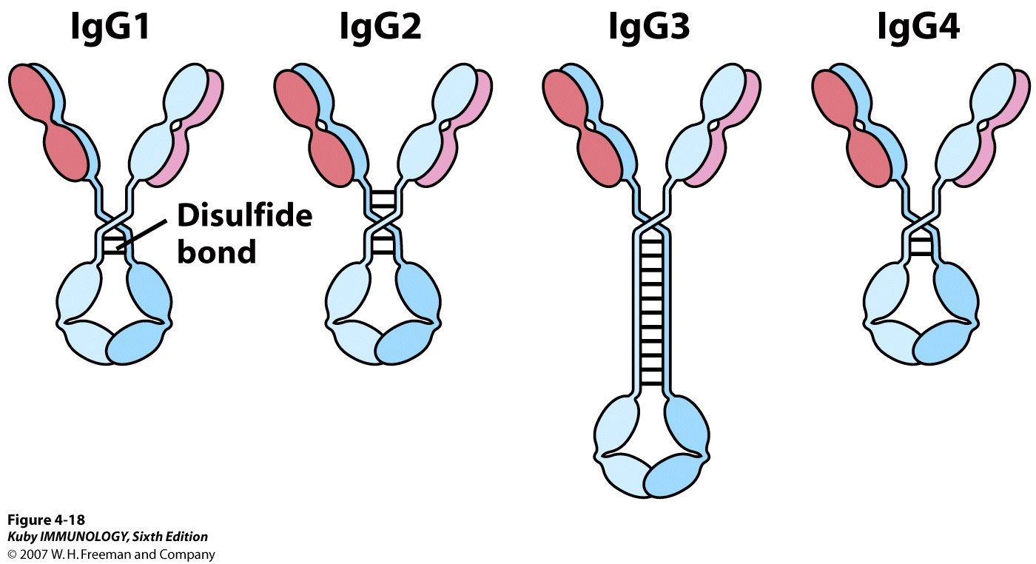
4 subclasses of human IgG
size of the hinge region
no. & position of the interchain -S-S- bond
- IgG1>IgG2>IgG3>IgG4 in serum conc.
90% - 95% homologous in DNA sequences
varied effectiveness in placenta transfer and C activation

Slide 43
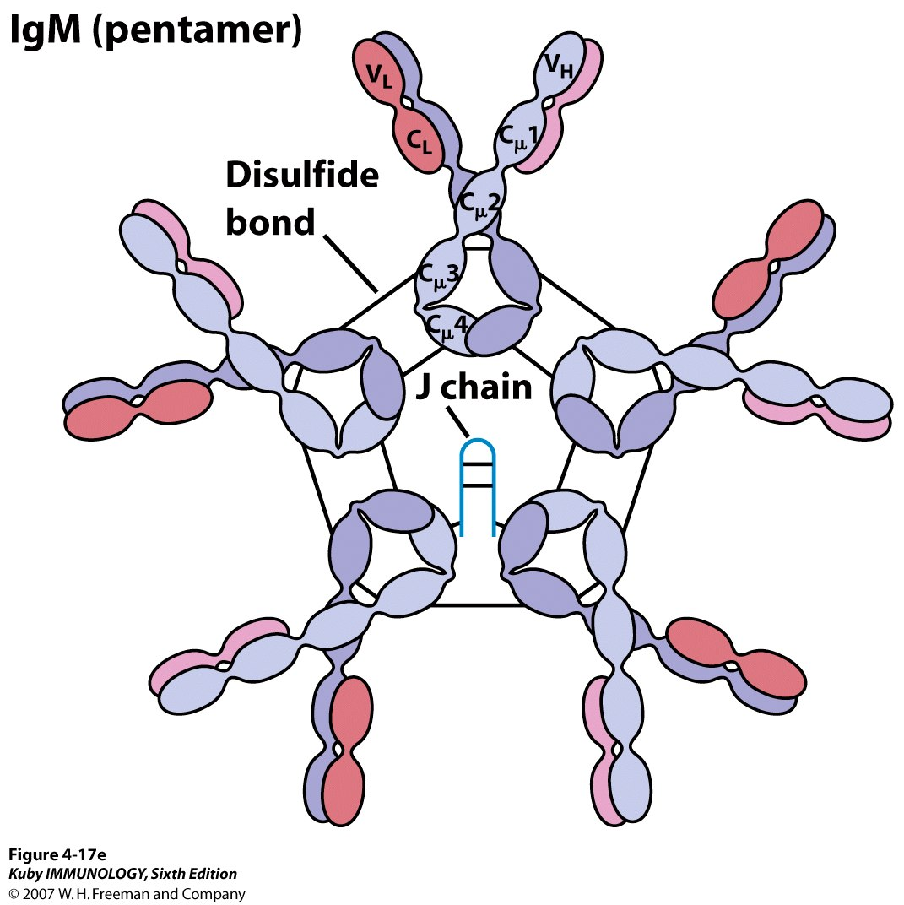
IgM Pentamer
- monomer on the membrane
& pentamer in secretion
- 5% - 10% serum Ig
- 1st Ab in neonates
- 1st Ab in primary
response
- more efficient in
agglutination & C fixation
- J (joining) chain is
required for polymerization
of the monomers to form
pentameric IgM
- also present in mucosal
surfaces

Slide 44
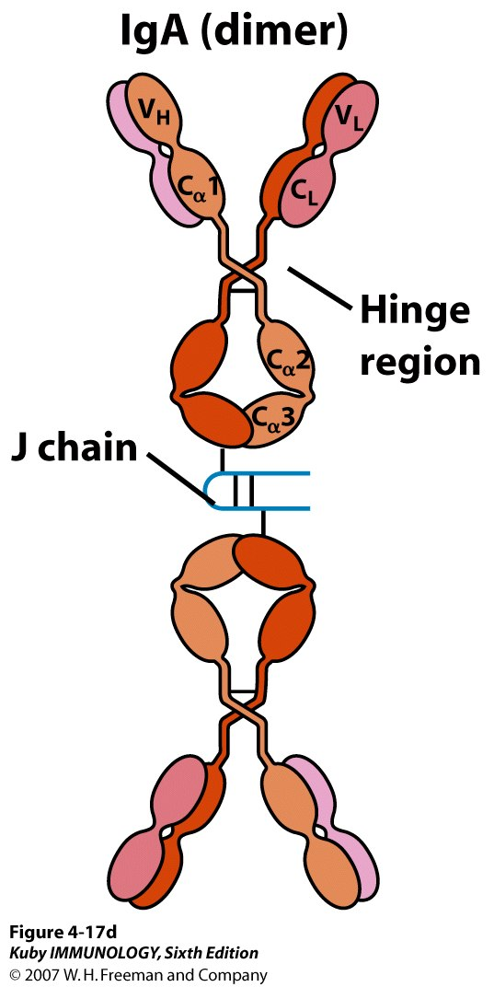
IgA Dimer
10% - 15% of total serum Ig
monomers, dimers, trimers and
tetramers in serum
- predominant in external secretions,
e.g., breast milk, saliva, tears, and
mucus of the bronchial, genitourinary,
and digestive tracts

Slide 45
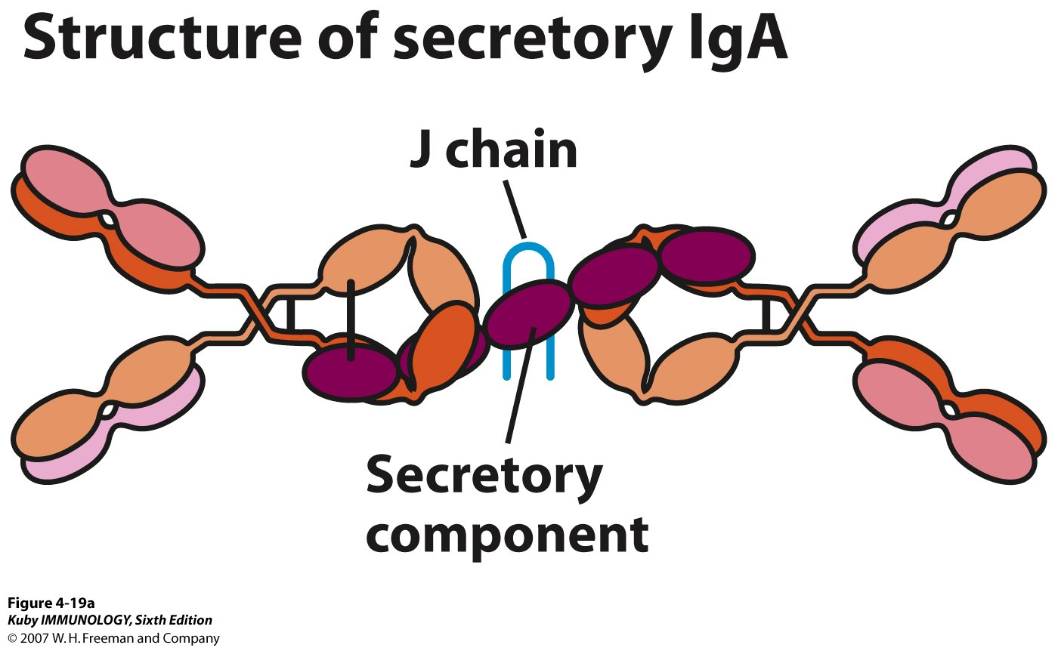
Secretory IgA
Dimers and tetramers in secretion with a secretory component

Slide 46
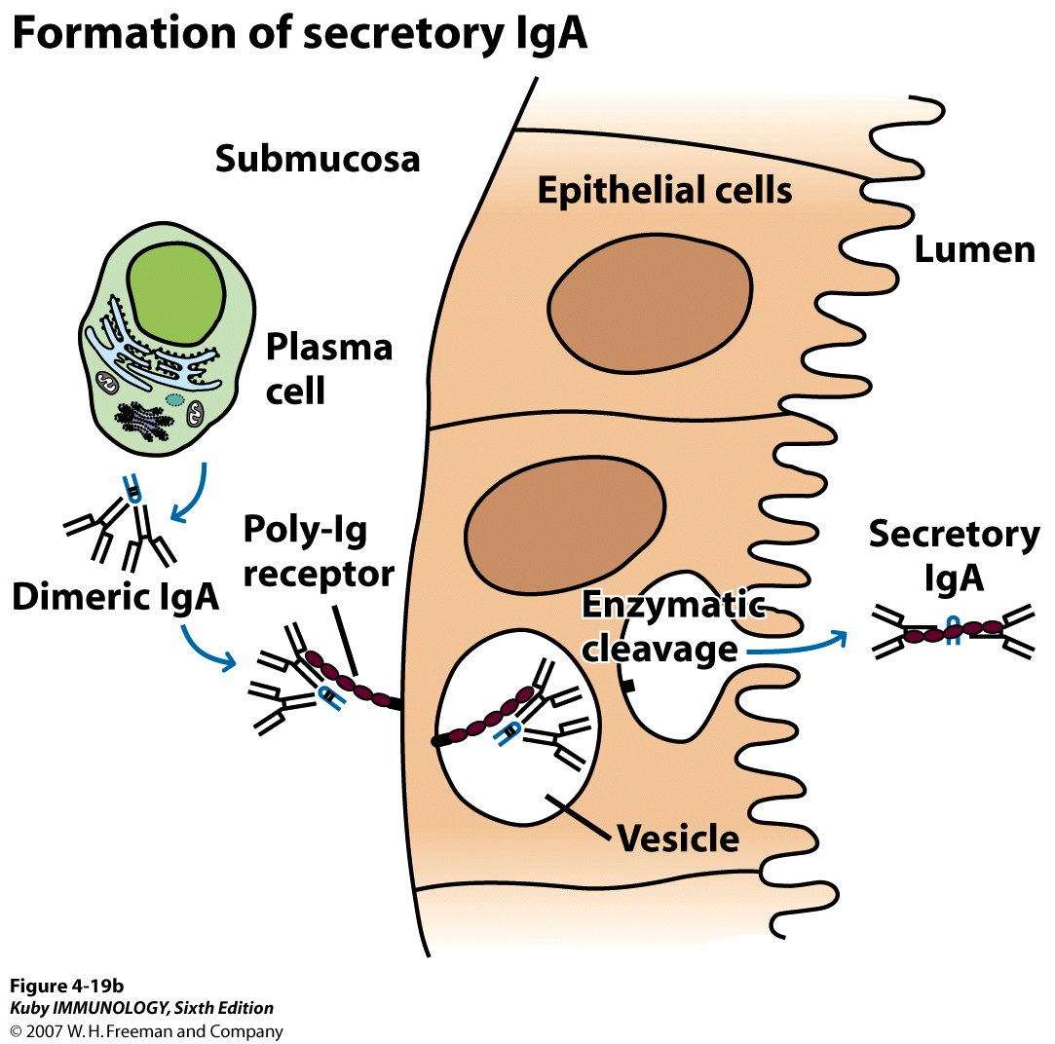
Formation of Secretory IgA
Transcytosis

Slide 47
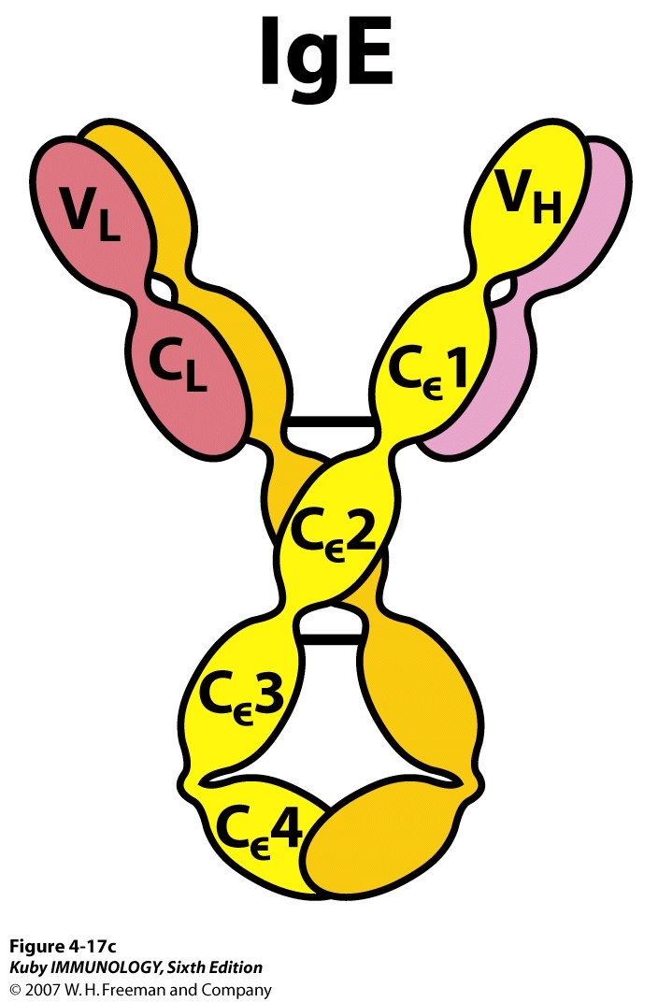
IgE
potent biological activity
extremely low conc. in serum
- mediates the immediate hyper-
sensitivity reactions
responsible for the symptoms
of hay fever, asthma, hives, and
anaphylactic shock

Slide 48
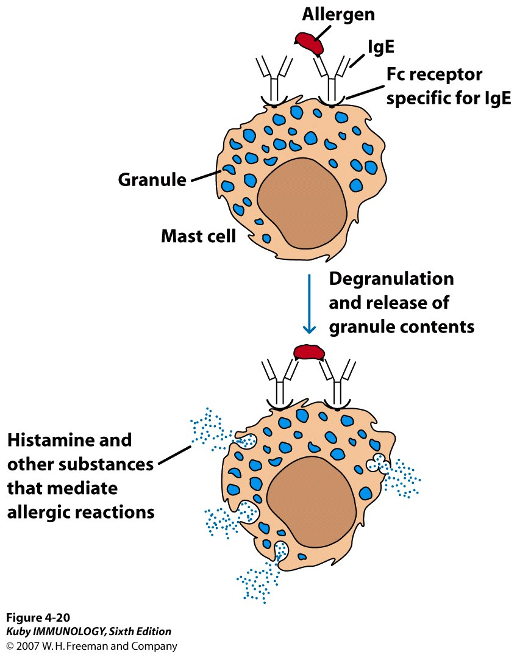
Allergen cross-linkage of receptor-
bound IgE on mast cells
- induces degranulation, causing
release of substances that mediate
allergic manifestations

Slide 49
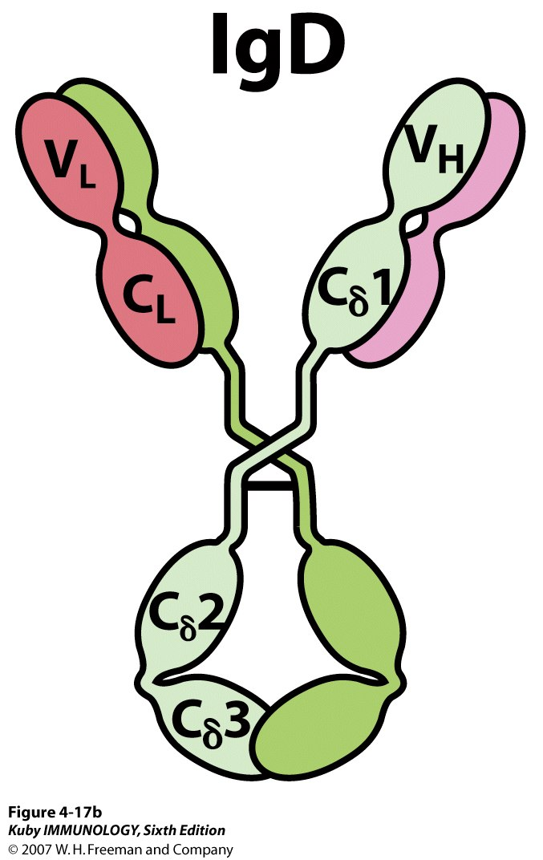
IgD
0.2% of total serum Ig
- together with IgM, is the
major membrane-bound Ig
on mature B cells
thought to function in the
activation of B cells
no biological effector
function has been identified

Slide 50
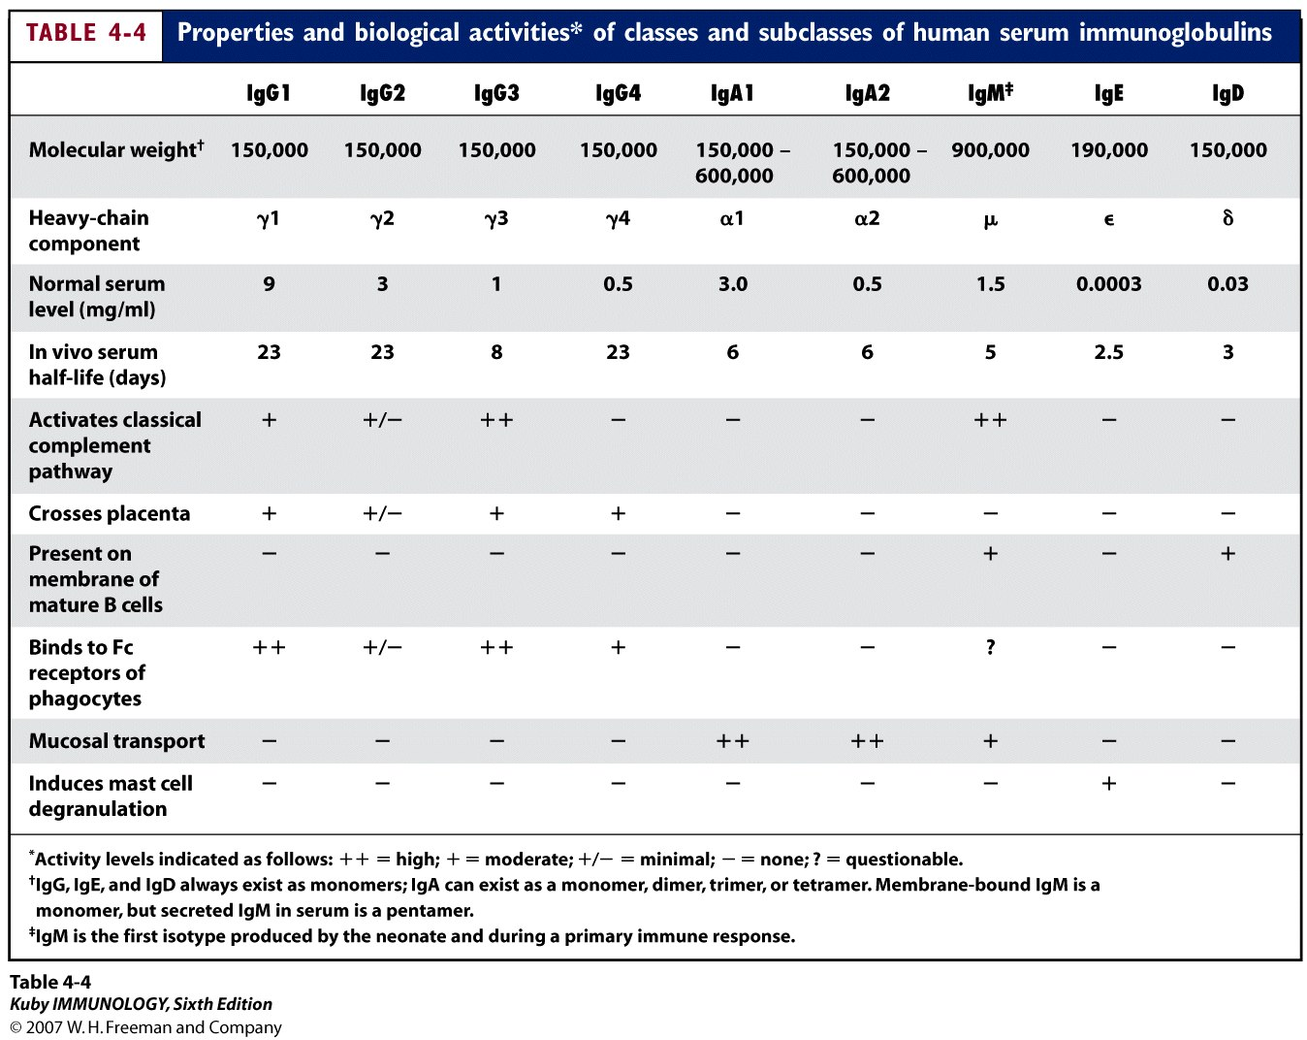

Slide 52
 | IgG | IgA | IgM | IgD | IgE
Other Name | Serum Ig | Secretory Ig | Pentameric Ig | ___ | Reagenic Ig
Other Notes | -can cross the placenta except IgG2 -major Ig in 2º Immune response | -predominant Ig in secretion -with J chain -exist as monomer in serum and dimer in secretion | -predominant Ig in 1º immune response -has J chain | -involved in B cell activation -susceptible to enzyme degradation -Heat & Acid Labile | - asso. w/ Immediate Hypersensitivity - binds basophils and mast cells - elevated during parasitic infections

Slide 53
Antigenic determinants on Igs

Slide 54
Fc receptors - essential for many of the
biological functions of Abs
movement of Abs across cell membranes, e.g.,
the transfer of IgG from mother to fetus across
the plancenta
passive acquisition of Ab by many cell types,
including B and T lymphocytes, neutrophils,
mast cells, eosinophils, macrophages, and natural
killer cells (a linker between Ab molecules and
various types of cells)

Slide 55
The Ig superfamily

Slide 56
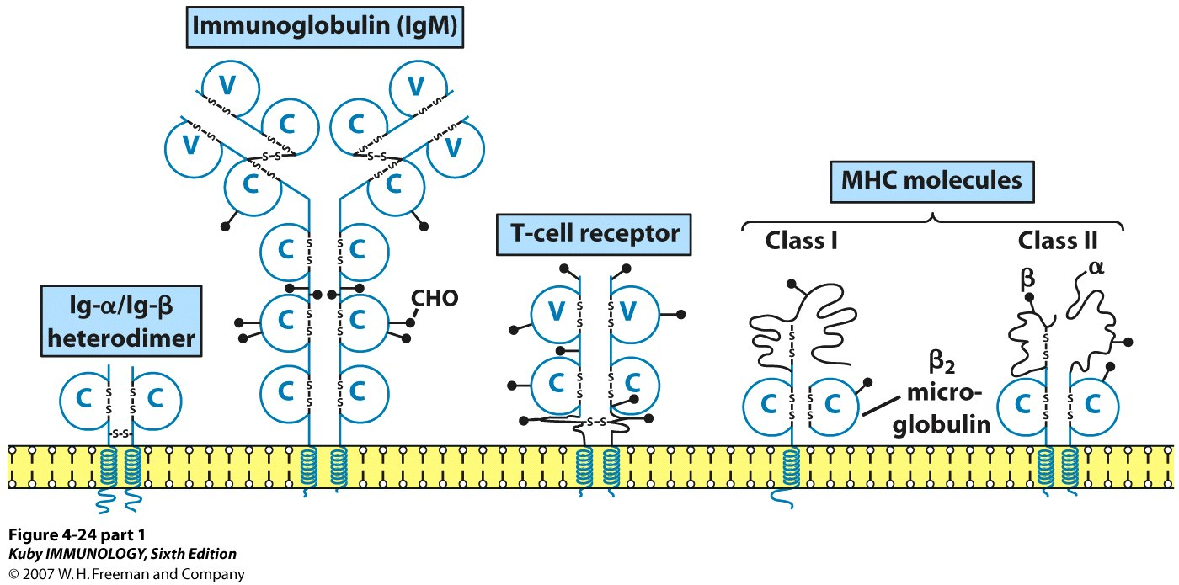
The Ig superfamily -1

Slide 57
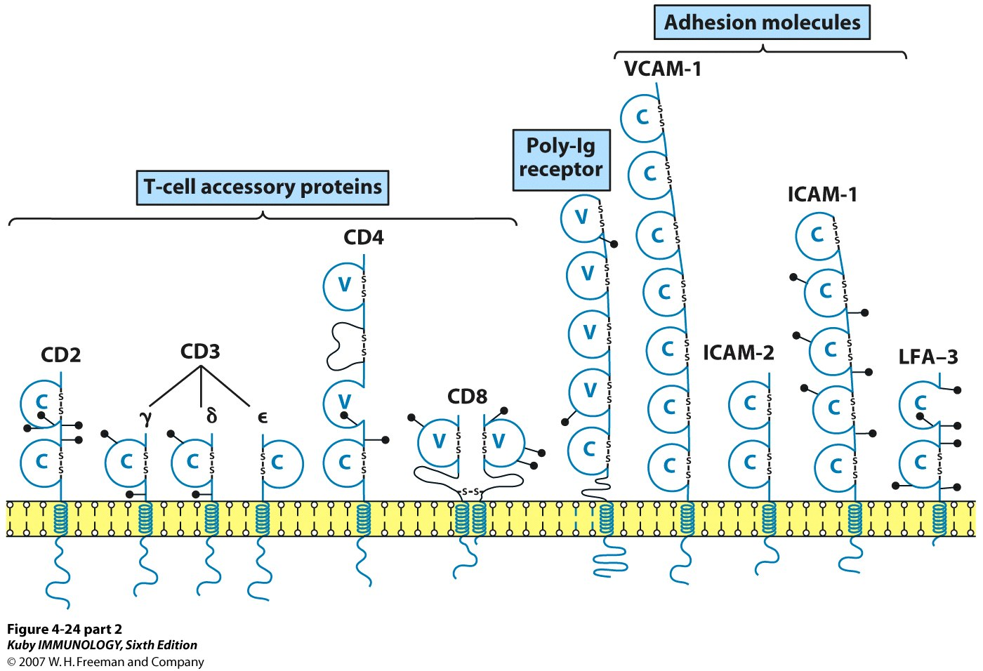
The Ig superfamily -2

Slide 58
Monoclonal Abs

Slide 59
Clonal Selection of B Lymphocytes

Slide 60
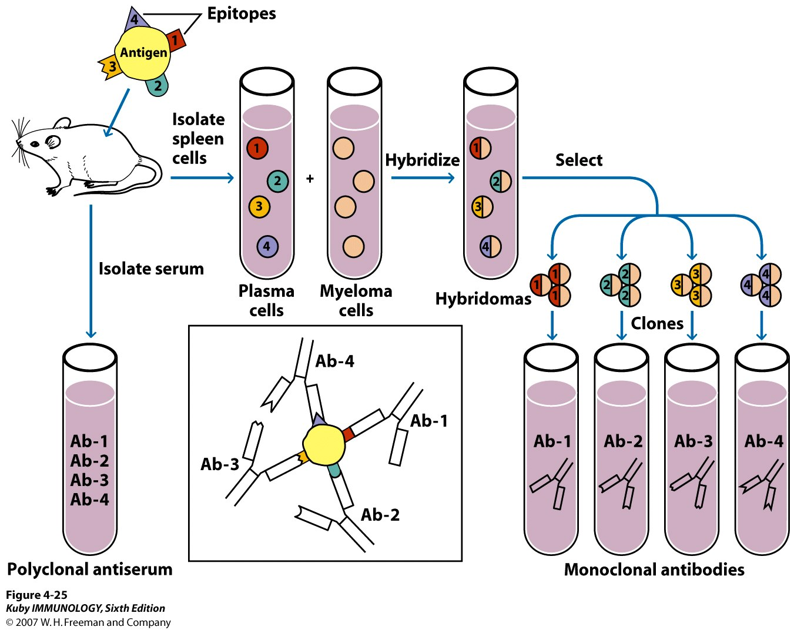
Production of monoclonal antibodies (mAb)

Slide 61
TAKE HOME MESSEGE/ FOR THE TOPIC COVERED (SUMMARY)
Immunogenicity versus antigenicity
Paratopes
Basic structure of antibodies (Abs)
Ab-binding site
Ab-mediated effector functions
Ab classes and biological activities
Antigenic determinants on immunoglobulins(Ig)
The B-cell receptor
The Ig superfamily
Monoclonal Abs

Slide 62
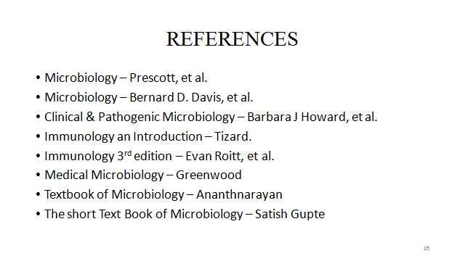

Slide 63
Question & Answer Session

Slide 64
THANK YOU

